Slide 1

Uttara university
Welcome To
MY
Presentation

Slide 2

“Mathematical Methods”
Presentation on

Slide 3

Presenting By
Name: Md. Sobuj Ali
ID: 2233151040
Department of Mathematics
Uttara University
Presenting To
Professor Dr. Shahansha Khan
Professor and Chairman
Uttara University

Slide 4

OverView
Orthogonal Functions
Orthonormal Functions
Weight Function
Self Adjoint Operator
Eigen Values & Eigen Functions
Laplace Transform
Inverse Laplace Transform
Fourier Series

Slide 5

Introduction
Mathematical Methods is an important branch of applied mathematics that deals with advanced analytical techniques used to solve mathematical, physical, and engineering problems. These methods provide systematic procedures for transforming complex problems into simpler mathematical forms so that accurate and meaningful solutions can be obtained.
In higher mathematics and engineering, many problems such as vibration analysis, heat conduction, wave motion, electrical circuit analysis, and signal processing cannot be solved easily by elementary mathematical techniques. Mathematical methods overcome these difficulties by introducing concepts such as orthogonal functions, eigen values, transform methods, and Fourier analysis.

Slide 6

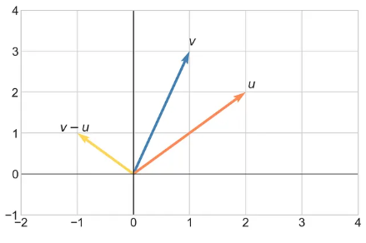
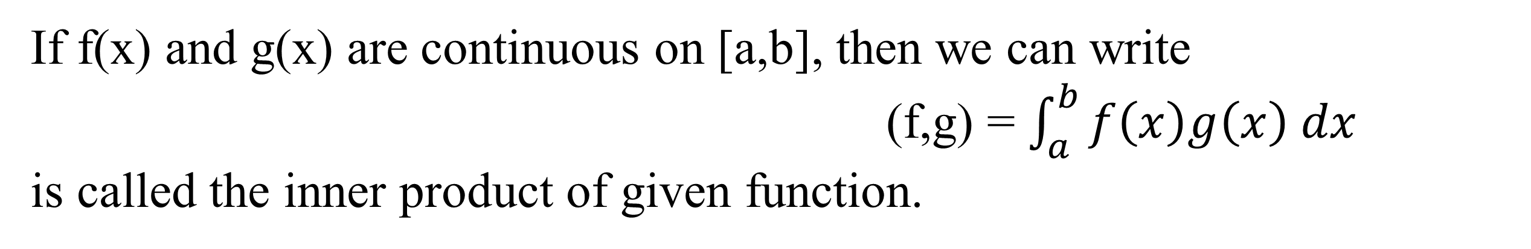
Mathematical Methods is an important branch of applied mathematics that deals with advanced analytical techniques used to solve mathematical, physical, and engineering problems. These methods provide systematic procedures for transforming complex problems into simpler mathematical forms so that accurate and meaningful solutions can be obtained.
In higher mathematics and engineering, many problems such as vibration analysis, heat conduction, wave motion, electrical circuit analysis, and signal processing cannot be solved easily by elementary mathematical techniques. Mathematical methods overcome these difficulties by introducing concepts such as orthogonal functions, eigen values, transform methods, and Fourier analysis.
Inner Product of Functions
If f(x) and g(x) are continuous on [a,b], then we can write
(f,g) = $\int_{a}^{b}{f\left(x\right)g\left(x\right) dx}$
is called the inner product of given function.
Inner product of functions is analogous to
dot product of vectors.

Slide 7

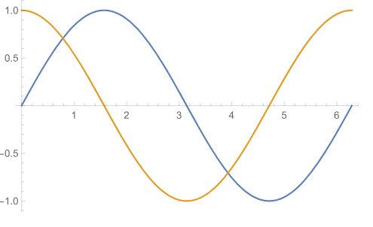
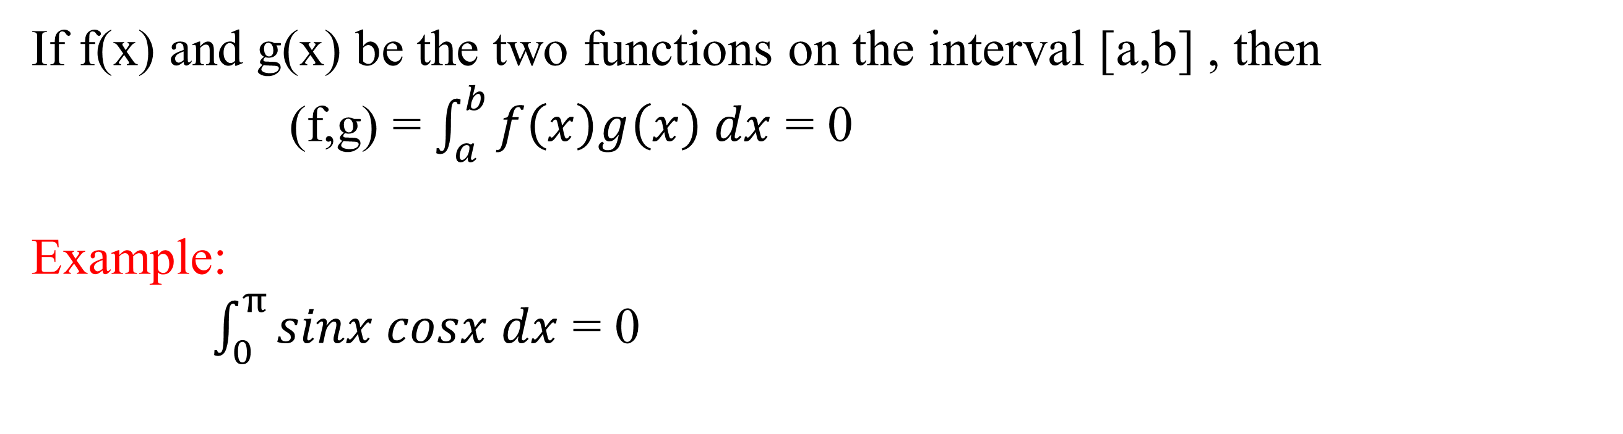
Orthogonal Functions
If f(x) and g(x) be the two functions on the interval [a,b] , then
(f,g) = $\int_{a}^{b}{f\left(x\right)g\left(x\right) dx}$ = 0
Example:
$\int_{0}^{π}{sinx cosx dx}$ = 0
Inner product zero → Orthogonal

Slide 8

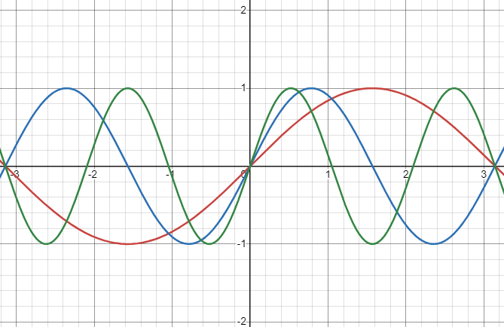
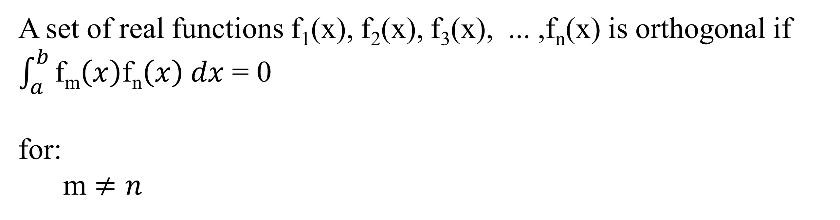
Set of Orthogonal functions
A set of real functions f₁(x), f₂(x), f₃(x), ... ,f_{n}(x) is orthogonal if $\int_{a}^{b}{\text{f}\text{m}\left(x\right)\text{f}\text{n}\left(x\right) dx}$ = 0
for:
m $≠n$
Example:
{sin nx} is orthogonal on [0,π]

Slide 9
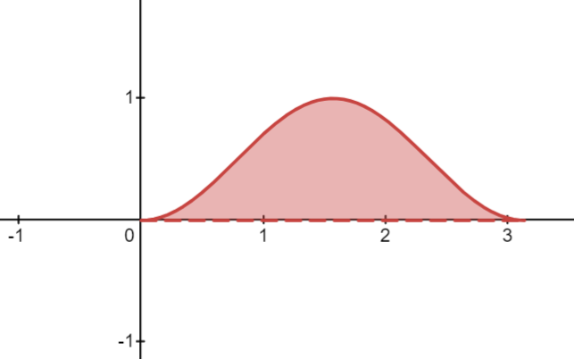

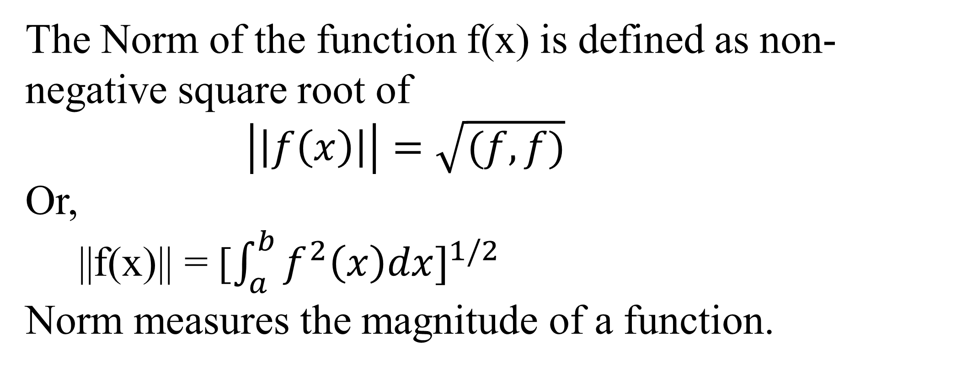
Norm of a function
The Norm of the function f(x) is defined as non-negative square root of
$\left|\left|f\left(x\right)\right|\right|=\sqrt{(f,f)}$
Or,
||f(x)|| = [$\int_{a}^{b}{f^{2}\left(x\right)dx}]^{1/2}$
Norm measures the magnitude of a function.
When, ||f(x)|| = [$\int_{a}^{b}{f^{2}\left(x\right)dx}]^{1/2}$=1
Then the given function Normalize function

Slide 10

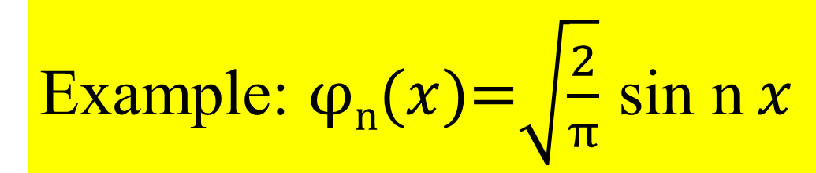
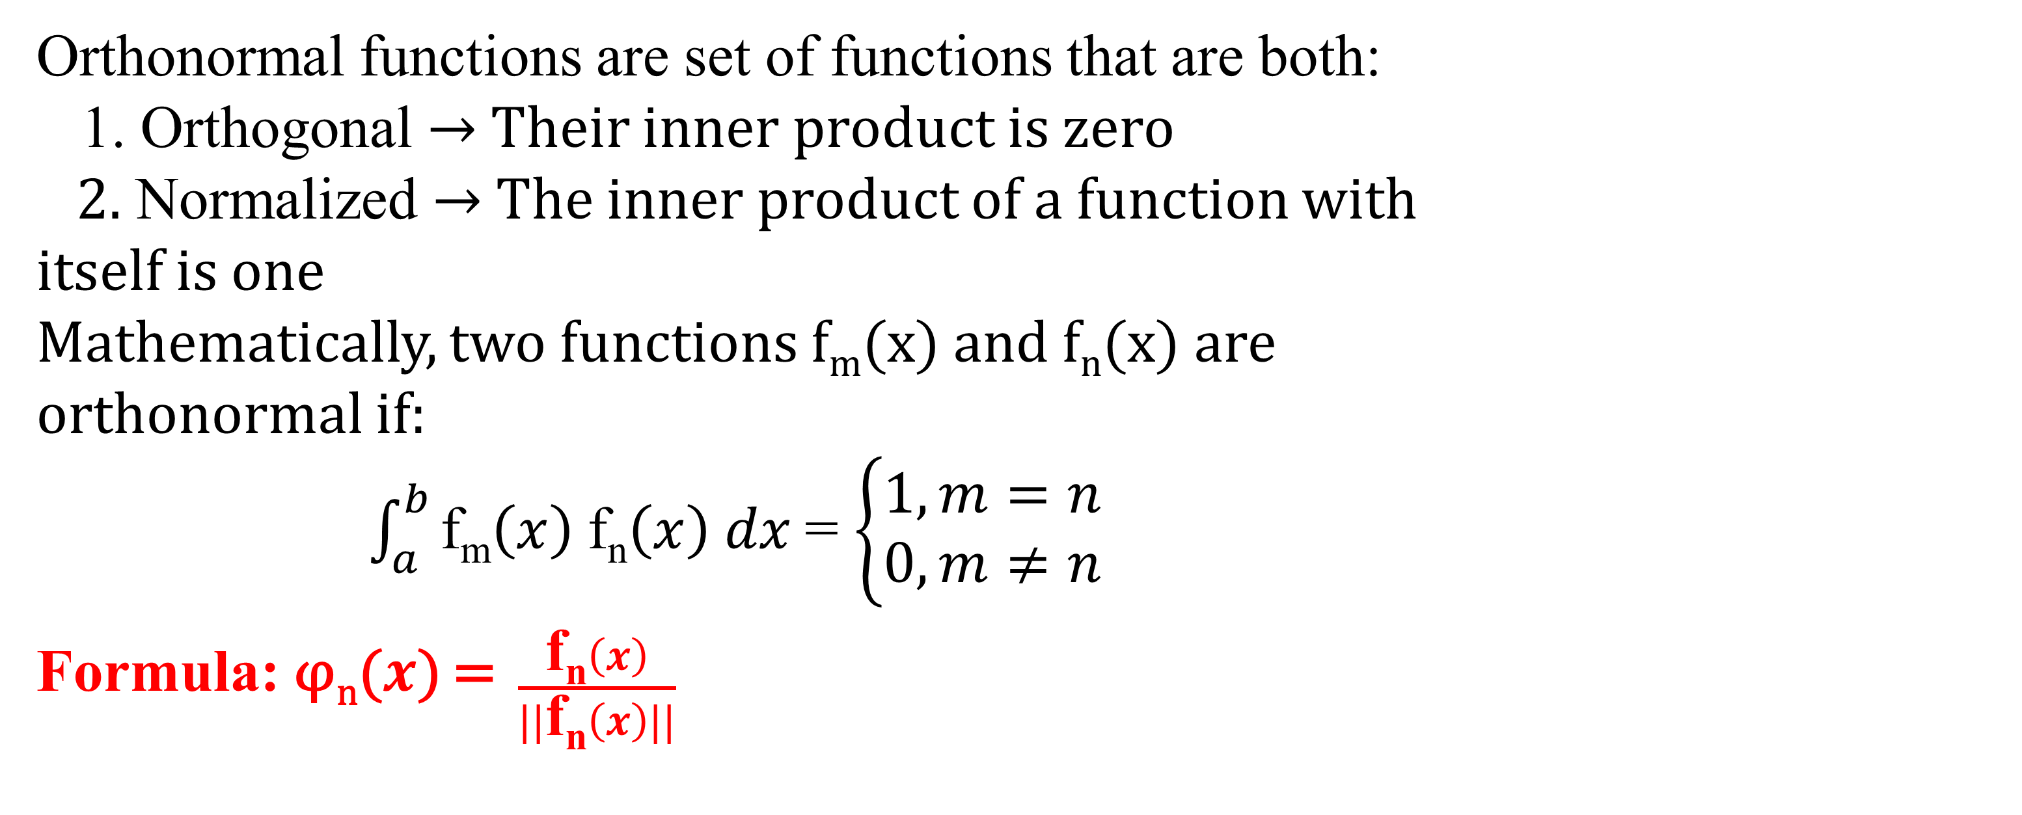
Orthonormal Functions
Orthonormal functions are set of functions that are both:
1. Orthogonal → Their inner product is zero
2. Normalized → The inner product of a function with itself is one
Mathematically, two functions f_{m}(x) and f_{n}(x) are orthonormal if:
$\int_{a}^{b}{\text{f}\text{m}\left(x\right) \text{f}\text{n}\left(x\right) dx}$= $\left\{\begin{aligned}1, m=n \\ 0, m≠n\end{aligned}\right.$
Formula: φ_{n}($x$) = $\frac{\text{f}\text{n}\left(x\right)}{||\text{f}\text{n}\left(x\right)||}$
Example: φ_{n}($x$)=$\sqrt{\frac{2}{π}}$ sin n $x$

Slide 11

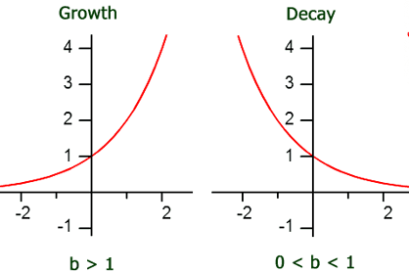

Weight Function
De$f^{n}$: A set of real functions {φ₁($x$), φ₂($x$), … ,φ_{n}($x$)} is orthogonal respect a function w(x) on an interval [a,b]
$\int_{a}^{b}{w(x)\text{φ}\text{n}\text{(}x\text{)\}}dx}$ = 0 but $m≠n$
Example: w(x)= $e^{−x}$
Weight function assigns different importance to different regions.

Slide 12

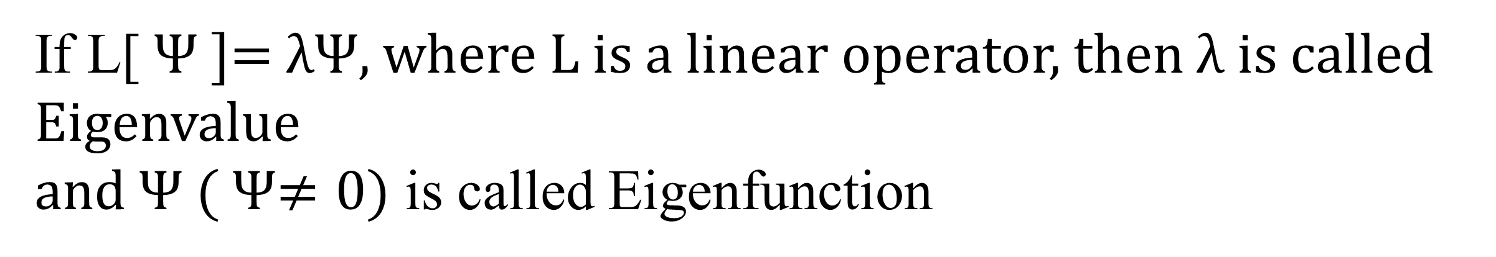
Eigenvalues & Eigenfunctions
If L[ Ψ ]= λΨ, where L is a linear operator, then λ is called Eigenvalue
and Ψ ( Ψ$≠0)$ is called Eigenfunction
Example: y’’+λy=0
Solution depends on boundary conditions
Only specific values of λ are allowed → Eigenvalues
Key Properties:
Eigenfunctions are orthogonal ( if λ different)
Eigenvalues are usually real ( for self-adjoint operators)
Set of eigenfunctions is complete

Slide 13

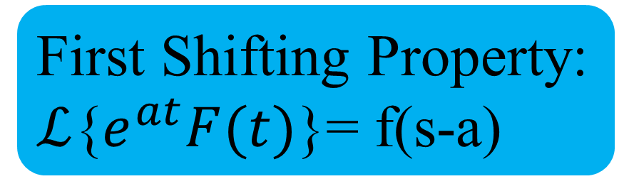

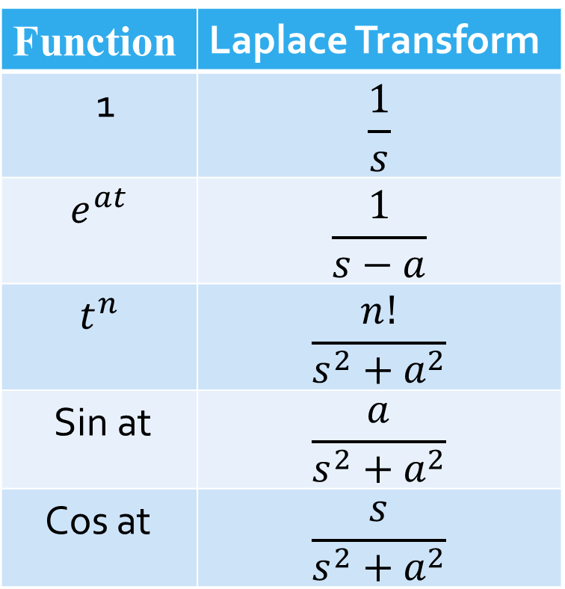
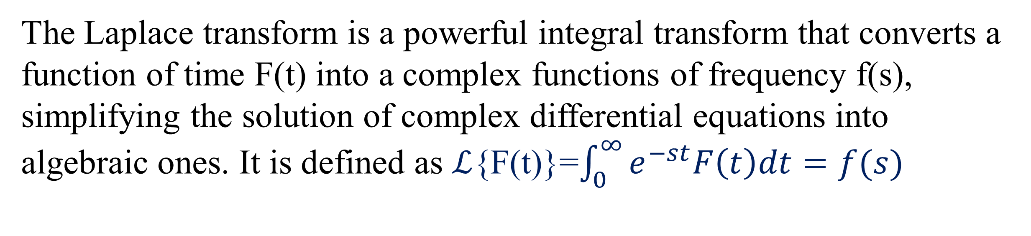
Introduction to Laplace Transform
The Laplace transform is a powerful integral transform that converts a function of time F(t) into a complex functions of frequency f(s), simplifying the solution of complex differential equations into algebraic ones. It is defined as $ℒ${F(t)}=$\int_{0}^{∞}{e^{−st}F\left(t\right)dt=f(s)}$
Linearity Property:
$ℒ${af(t)+bg(t)}=a$ℒ${f(t)}+b$ℒ${g(t)}
Example: $ℒ${3t+2 sint}=$\frac{3}{s^{2}}+\frac{2}{s^{2}+1}$
Basic Laplace Formulas:
Applications:
Electrical circuits
Control systems
Signal processing
Function | Laplace Transform
1 | $$\frac{1}{s}$$
$$e^{at}$$ | $$\frac{1}{s−a}$$
$$t^{n}$$ | $$\frac{n!}{s^{2}+a^{2}}$$
Sin at | $$\frac{a}{s^{2}+a^{2}}$$
Cos at | $$\frac{s}{s^{2}+a^{2}}$$
First Shifting Property:
$ℒ${$e^{at}F(t)$}= f(s-a)
Example:
$ℒ${$e^{2t}\sin{t}$}=$\frac{1}{{\left(s−2\right)}^{2}+1}$

Slide 14

Second Shifting Properties
We know from the defination of laplace transform
$ℒ${F(t)}=$\int_{0}^{∞}{e^{−st}F\left(t\right)dt=f(s)}$
Now, G(t) = $\left\{ \begin{aligned}F\left(t−a\right) when t≥a \\ 0 when t<a \end{aligned}\right. ℒ${G(t)}= $e^{−as}$.f(s)
Example: G(t) = $\left\{ \begin{aligned}cos\left(t−\frac{2π}{3}\right) when t≥\frac{2π}{3} \\ 0 when t<\frac{2π}{3} \end{aligned}\right.$
Let, F(t)=cost
$ℒ${G(t)}= $e^{−\frac{2π}{3}s}.\frac{s}{s^{2}+1}$

Slide 15

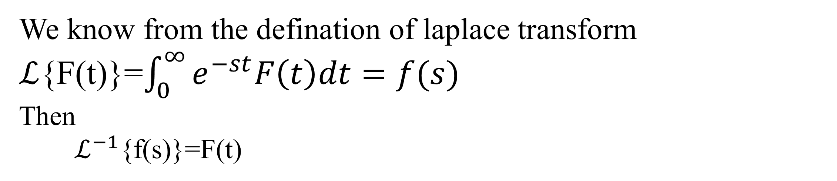
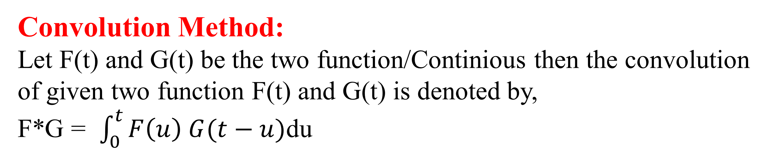
Inverse Laplace Transform
We know from the defination of laplace transform
$ℒ${F(t)}=$\int_{0}^{∞}{e^{−st}F\left(t\right)dt=f(s)}$
Then
$ℒ^{−1}${f(s)}=F(t)
Example: F(t) = sin at
$ℒ${sin at} = $\frac{a}{s^{2}+a^{2}}$ = f(s)
Now, $ℒ^{−1}${$\frac{a}{s^{2}+a^{2}}$}=sin at
Convolution Method:
Let F(t) and G(t) be the two function/Continious then the convolution of given two function F(t) and G(t) is denoted by,
F*G = $\int_{0}^{t}{F\left(u\right) G(t−u)}$du
Applications
Systems analysis
Signal processing

Slide 16

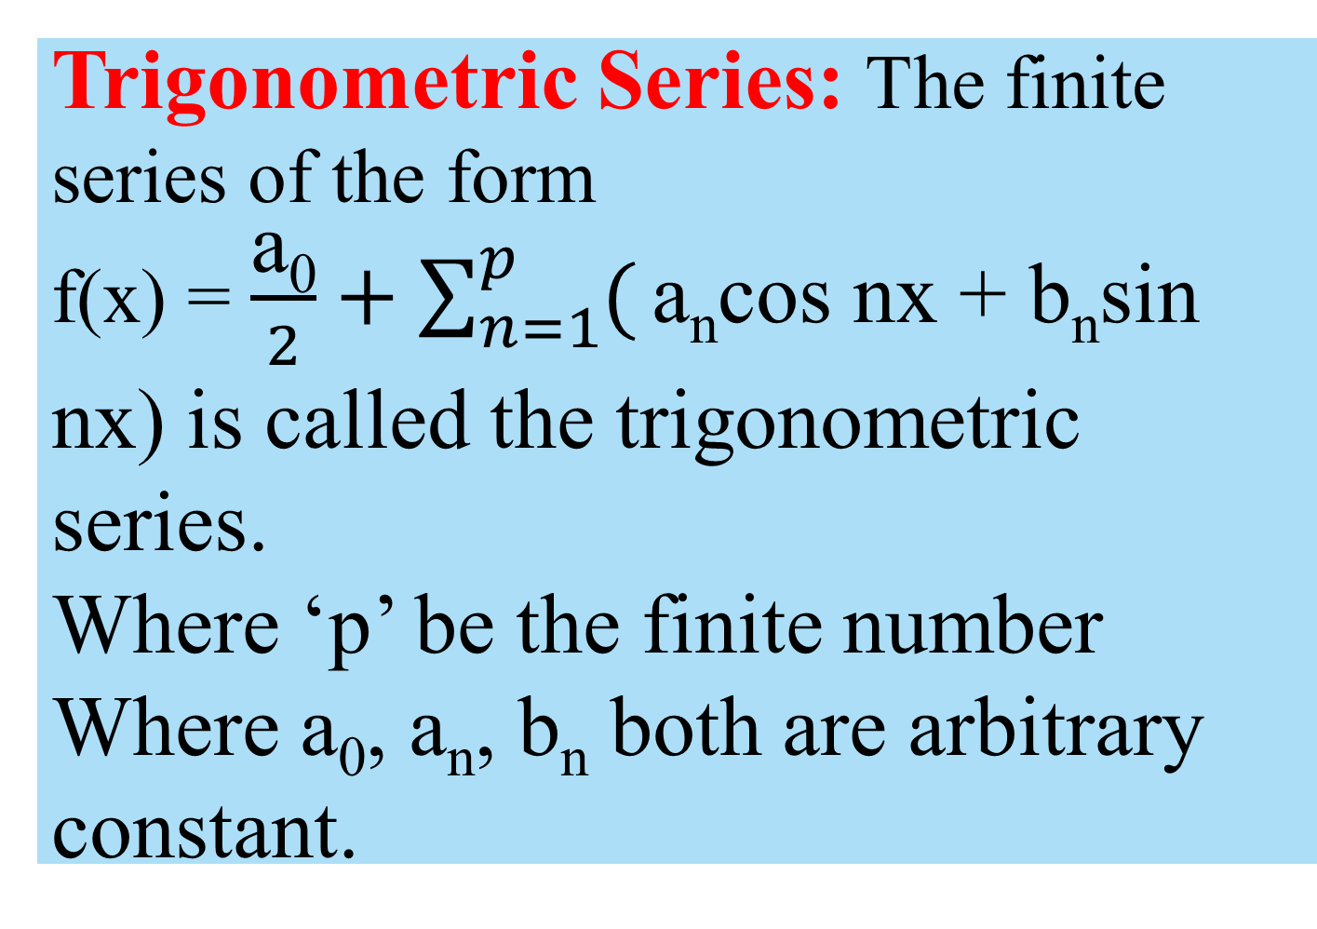
Fourier Series
Periodic function:
A function f(x) is said to be periodic functions it satisfy the condition f(x+T) = f(x)
Where T be the period.
The general form of the periodic function of sin/cos function is
f(x) = asin(bx-c)+d
f(x) = acos(bx-c)+d
Trigonometric Series: The finite series of the form
f(x) = $\frac{\text{a}\text{0}}{2}+\sum_{n=1}^{p}{(}\text{a}\text{n}$cos nx + $\text{b}\text{n}$sin nx) is called the trigonometric series.
Where ‘p’ be the finite number
Where $\text{a}\text{0}$, $\text{a}\text{n}$, $\text{b}\text{n}$ both are arbitrary constant.
Where a= amplitude
bx-c = angular momentum
d = Phase shift

Slide 17

Fourier Coefficients
$a\text{0}$= $\frac{1}{π}\int_{−π}^{π}{f(x)}$
$a\text{n}$= $\frac{1}{π}\int_{−π}^{π}{f\left(x\right)\cos{nx dx }}$
$b\text{n}$= $\frac{1}{π}\int_{−π}^{π}{f\left(x\right)\sin{nx dx}}$
Then the series is called Fourier series.
Applications:
Heat equation
Wave equation
Audio systems
Image compression
Communication system
Difference between Fourier & Laplace
Fourier Series | Laplace Transform
Used for periodic functions | Used for general functions
Harmonic analysis | Differential equations
Uses sine & cosine | Uses exponential kernel

Slide 18

Summary
Mathematical Methods provides powerful analytical techniques for solving complex mathematical and engineering problems. In this presentation, important concepts such as orthogonal and orthonormal functions, weight functions, self adjoint operators, eigen values and eigen functions, Laplace transform, inverse Laplace transform, and Fourier series have been discussed. These methods simplify differential equations, functional analysis, and periodic signal representation, making them essential tools in modern applied mathematics and engineering sciences.

Slide 19

Conclusion
Mathematical methods form the theoretical foundation of many modern scientific and engineering applications. Among these techniques, the Laplace Transform is especially significant because it converts difficult differential equations into simpler algebraic forms. Fourier series, eigen function analysis, and orthogonal systems also play vital roles in signal processing, vibration analysis, communication systems, and mathematical modeling. Therefore, mathematical methods are indispensable for understanding and solving real-world physical and engineering problems efficiently.

Slide 20
Reference
Advanced Engineering Mathematics — Erwin Kreyszig
Differential Equations with Boundary-Value Problems — Dennis G. Zill & Warren S. Wright
Elementary Differential Equations and Boundary Value Problems — Boyce & DiPrima
Lecture Notes on Mathematical Methods

Slide 21


Slide 22


